Slide 1
5 Year Youth Suicide Deaths For Georgia: 2012-2016
Totals by Year
2012-32
2013-36
2014-30
2015-51
2016-35*
* 2016 data is not all inclusive
Source: Child Fatality Review Unit

Slide 2
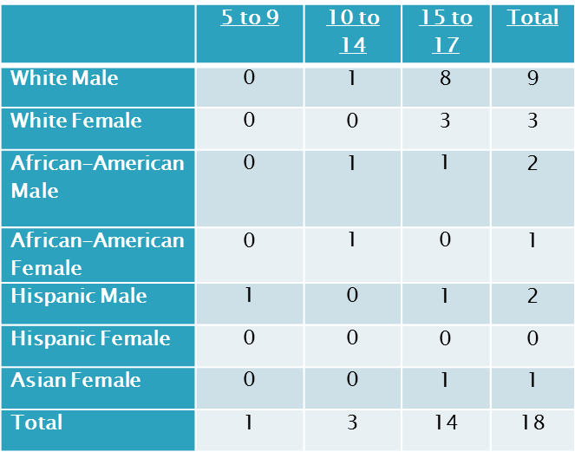
Youth Suicide Data for Georgia: 2017
 | 5 to 9 | 10 to 14 | 15 to 17 | Total
Gunshots | 1 | 2 | 7 | 10
Hangings | 0 | 1 | 5 | 6
Overdose | 0 | 1 | 1 | 2
Total | 1 | 4 | 13 | 18
Source: GBI Child Fatality Review Unit

